Slide 1
Towards the construction of Personas with PCA on Multi-source Data
Martin Talbot
Jan 2016
mtalbot@square-enix-montreal.com

Slide 2
R – Library and Loading Data
rm(list = ls())
#install.packages("reshape")
#install.packages("multcomp")
#install.packages("vcd")
#install.packages("Rcpp")
#install.packages("FactoMineR")
library(reshape)
library(multcomp)
library(vcd)
library(Rcpp)
library(FactoMineR)
# setting path to access my csv file
setwd("C:/Users/mtalbot/Documents/RStudioFiles/Work-SEM")
mydata<- read.csv(file="lcgo_CrossData8.csv",head=TRUE,sep=",")
Change to match the location of the file in your own PC

Slide 3
Remove and Rename Columns
######################################
# Rename
######################################
names(mydata) <-
c(
"EMAIL"
,"FEEDBACK TAG"
,"LCGO VERSION"
,"s__UID"
,"lastestPuzzleID"
,"nbOfDistinctPuzzlesPlayed"
,"totalTimePlayed"
,"nbSuccesses"
,"nbFailures"
,"nbBrokenVases"
,"purchasedHints"
,"purchasedSuits"
,"BomberSuit"
,"Area51Suit"
,"AntarcticaSuit"
,"WetSuit"
,"CatSuit"
,"MidasSuit"
,"LANGUAGE"
,"TOKEN"
,"COMPLETE"
,"TS"
,"PROGRESS"
,"Hitman.GO.Influence"
,"Tomb.Raider.Influence"
,"Graphics.Influence"
,"Turn.based.puzzle.Influence"
,"Satisfaction"
,"NPS"
,"HavePlayedLC.TR.B4"
,"HavePlayed.TR.2013.PC.Console"
,"HavePlayed.TR.Mobile"
,"HavePlayed.Hitman.GO"
,"Watched.LC.Movie"
,"WhereFirstHearOfLC"
,"Combat.City.Builder"
,"Brain.Puzzle"
,"Physic.Puzzle"
,"Card.Battle"
,"ActionFighting"
,"Shooter"
,"General.Strategy"
,"Tower.Defense"
,"Matching.Puzzle"
,"SkillChance"
,"Premium.gamesWeekPlaytime"
,"F2P.gamesWeekPlaytime"
,"PC.or.ConsoleWeekPlaytime"
,"Premium.games.WeekSpending"
,"F2P.WeekSpending"
,"P1"
,"P2"
,"P3"
,"P4"
,"P5"
,"Gender"
,"Age"
,"Education"
,"HouseholdIncome"
)
############################################
# Cast and Reduce
############################################
# remove undesirable dimensions from mydata and cast dimensions as numerical or categorical (factor)
mydata.sub <- data.frame(
as.numeric(mydata$lastestPuzzleID),
as.numeric(mydata$nbOfDistinctPuzzlesPlayed),
as.numeric(mydata$totalTimePlayed),
as.numeric(mydata$nbSuccesses),
as.numeric(mydata$nbFailures),
as.numeric(mydata$nbBrokenVases),
as.numeric(mydata$Hitman.GO.Influence) / 0.4, # scaling/10
as.numeric(mydata$Tomb.Raider.Influence) / 0.4,
as.numeric(mydata$Graphics.Influence) / 0.4,
as.numeric(mydata$Turn.based.puzzle.Influence) / 0.4,
as.numeric(mydata$Satisfaction) / 0.6,
as.numeric(mydata$NPS),
as.numeric(mydata$Combat.City.Builder) / 0.4,
as.numeric(mydata$Brain.Puzzle) / 0.4,
as.numeric(mydata$Physic.Puzzle)/ 0.4,
as.numeric(mydata$Card.Battle) / 0.4,
as.numeric(mydata$ActionFighting) / 0.4,
as.numeric(mydata$Shooter) / 0.4,
as.numeric(mydata$General.Strategy) / 0.4,
as.numeric(mydata$Tower.Defense) / 0.4,
as.numeric(mydata$Matching.Puzzle) / 0.4,
as.numeric(mydata$SkillChance) / 0.4,
as.factor(mydata$purchasedHints),
as.factor(mydata$purchasedSuits),
as.factor(mydata$BomberSuit),
as.factor(mydata$Area51Suit),
as.factor(mydata$AntarcticaSuit),
as.factor(mydata$WetSuit),
as.factor(mydata$CatSuit),
as.factor(mydata$MidasSuit), as.factor(mydata$HavePlayedLC.TR.B4),
as.factor(mydata$HavePlayed.TR.2013.PC.Console),
as.factor(mydata$HavePlayed.TR.Mobile),
as.factor(mydata$HavePlayed.Hitman.GO),
as.factor(mydata$Watched.LC.Movie),
as.factor(mydata$WhereFirstHearOfLC), as.factor(mydata$Premium.gamesWeekPlaytime),
as.factor(mydata$F2P.gamesWeekPlaytime),
as.factor(mydata$PC.or.ConsoleWeekPlaytime),
as.factor(mydata$Premium.games.WeekSpending),
as.factor(mydata$F2P.WeekSpending),
as.factor(mydata$P1),
as.factor(mydata$P2),
as.factor(mydata$P3),
as.factor(mydata$P4),
as.factor(mydata$P5),
as.factor(mydata$Gender),
as.factor(mydata$Age),
as.factor(mydata$Education),
as.factor(mydata$HouseholdIncome)
)
############################################
# Rename
############################################
names(mydata.sub) <-
c(
##### quantitative ##### 123
"lastestPuzzleID" # 1
,"nbOfDistinctPuzzlesPlayed" # 2
,"totalTimePlayed" # 3
,"nbSuccesses" # 4
,"nbFailures" # 5
,"nbBrokenVases" # 6
,"Hitman.GO.Influence" # 7
,"Tomb.Raider.Influence" # 8
,"Graphics.Influence" # 9
,"Turn.based.puzzle.Influence" #10
,"Satisfaction" #11
,"NPS" #12
,"Combat.City.Builder" #13
,"Brain.Puzzle" #14
,"Physic.Puzzle" #15
,"Card.Battle" #16
,"ActionFighting" #17
,"Shooter" #18
,"General.Strategy" #19
,"Tower.Defense" #20
,"Matching.Puzzle" #21
,"SkillChance" #22
##### Qualitative #### ABC
,"purchasedHints" #23
,"purchasedSuits" #24
,"BomberSuit" #25
,"Area51Suit" #26
,"AntarcticaSuit" #27
,"WetSuit" #28
,"CatSuit" #29
,"MidasSuit" #30
,"HavePlayedLC.TR.B4" #31
,"HavePlayed.TR.2013.PC.Console" #32
,"HavePlayed.TR.Mobile" #33
,"HavePlayed.Hitman.GO" #34
,"Watched.LC.Movie" #35
,"WhereFirstHearOfLC" #36
,"Premium.gamesWeekPlaytime" #37
,"F2P.gamesWeekPlaytime" #38
,"PC.or.ConsoleWeekPlaytime" #39
,"Premium.games.WeekSpending" #40
,"F2P.WeekSpending" #41
,"P1" #42
,"P2" #43
,"P3" #44
,"P4" #45
,"P5" #46
,"Gender" #47
,"Age" #48
,"Education" #49
,"HouseholdIncome" #50
)

Slide 4
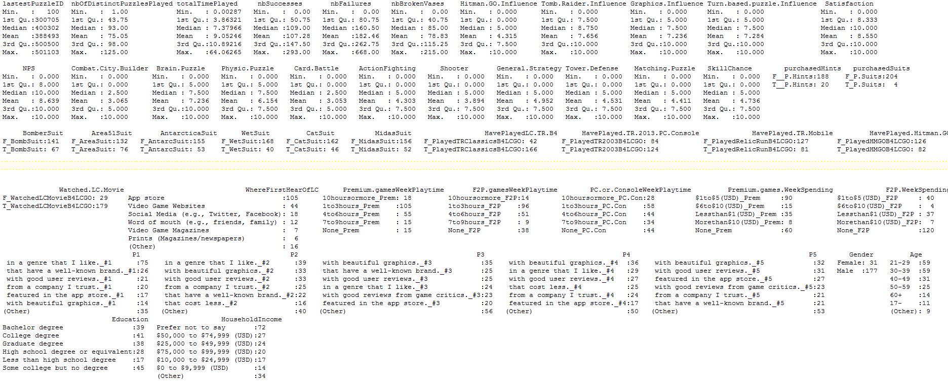
Summary of the Data
summary(mydata.sub)
BI Data
Survey Data
Survey Data
BI Data
BI Data
Survey Data
Note:
LatestPuzzleID is categorical but transformed into values because number increases with player’s progression
TotalTimePlayed in hours

Slide 5
FactoMineR
FactoMineR offers a rich library
We will only examine PCA and HCPC and a little of FAMD.
PCA (Principal Analysis for Quantitative Data)
FAMD (Factor analysis on Mixed data for a mixture of Quantitative and Categorical data)
HCPC (Hierarchical Clustering on Principal Components)
MCA (Multiple Correspondence Analysis for Categorical data)

Slide 6
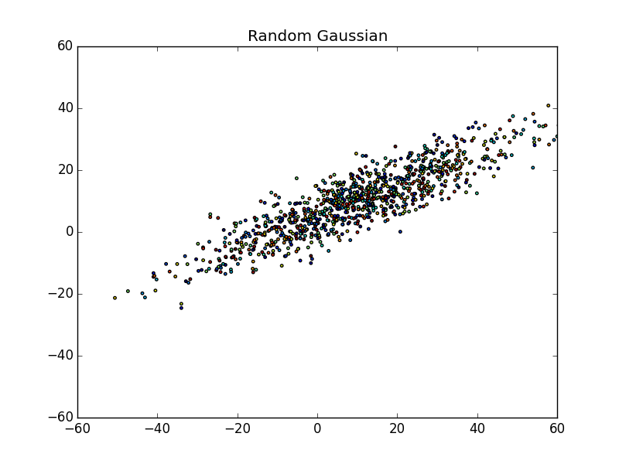
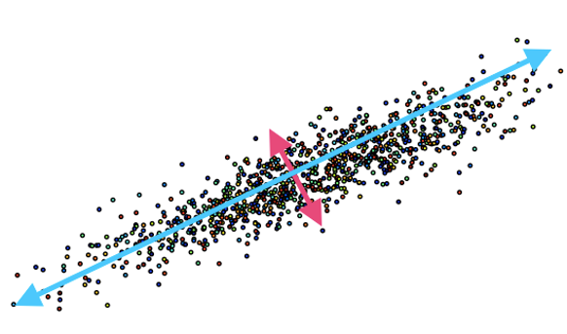
PCA Intuition
A Dimension réduction method.
PCA scales and rotates and projects the data on orthogonal axes (the new dimensions) in order to maximize the variance in the data.
Hypothesis: higher variance = richer information.
The PC axis are derived from SVD, which extracts the associated eigenvectors and eigenvalues from the diagonalization of the correlation matrix of the Data
Eigenvectors are vectors that represent the direction Eigenvalues are the length of the Eigenvectors and represent the variance of the dimension.

Slide 7
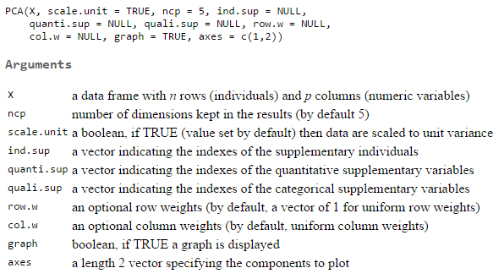
R – Compute PCA
names(mydata.sub) <-
c(
##### quantitative ##### 123
"lastestPuzzleID" # 1
,"nbOfDistinctPuzzlesPlayed" # 2
,"totalTimePlayed" # 3
,"nbSuccesses" # 4
,"nbFailures" # 5
,"nbBrokenVases" # 6
,"Hitman.GO.Influence" # 7
,"Tomb.Raider.Influence" # 8
,"Graphics.Influence" # 9
,"Turn.based.puzzle.Influence" #10
,"Satisfaction" #11
,"NPS" #12
,"Combat.City.Builder" #13
,"Brain.Puzzle" #14
,"Physic.Puzzle" #15
,"Card.Battle" #16
,"ActionFighting" #17
,"Shooter" #18
,"General.Strategy" #19
,"Tower.Defense" #20
,"Matching.Puzzle" #21
,"SkillChance" #22
##### Qualitative #### ABC
,"purchasedHints" #23
,"purchasedSuits" #24
,"BomberSuit" #25
,"Area51Suit" #26
,"AntarcticaSuit" #27
,"WetSuit" #28
,"CatSuit" #29
,"MidasSuit" #30
,"HavePlayedLC.TR.B4" #31
,"HavePlayed.TR.2013.PC.Console" #32
,"HavePlayed.TR.Mobile" #33
,"HavePlayed.Hitman.GO" #34
,"Watched.LC.Movie" #35
,"WhereFirstHearOfLC" #36
,"Premium.gamesWeekPlaytime" #37
,"F2P.gamesWeekPlaytime" #38
,"PC.or.ConsoleWeekPlaytime" #39
,"Premium.games.WeekSpending" #40
,"F2P.WeekSpending" #41
,"P1" #42
,"P2" #43
,"P3" #44
,"P4" #45
,"P5" #46
,"Gender" #47
,"Age" #48
,"Education" #49
,"HouseholdIncome" #50
)
mydata.sub.pca <- PCA(mydata.sub, quali.sup = 23:50, graph=FALSE )
?PCA

Slide 8
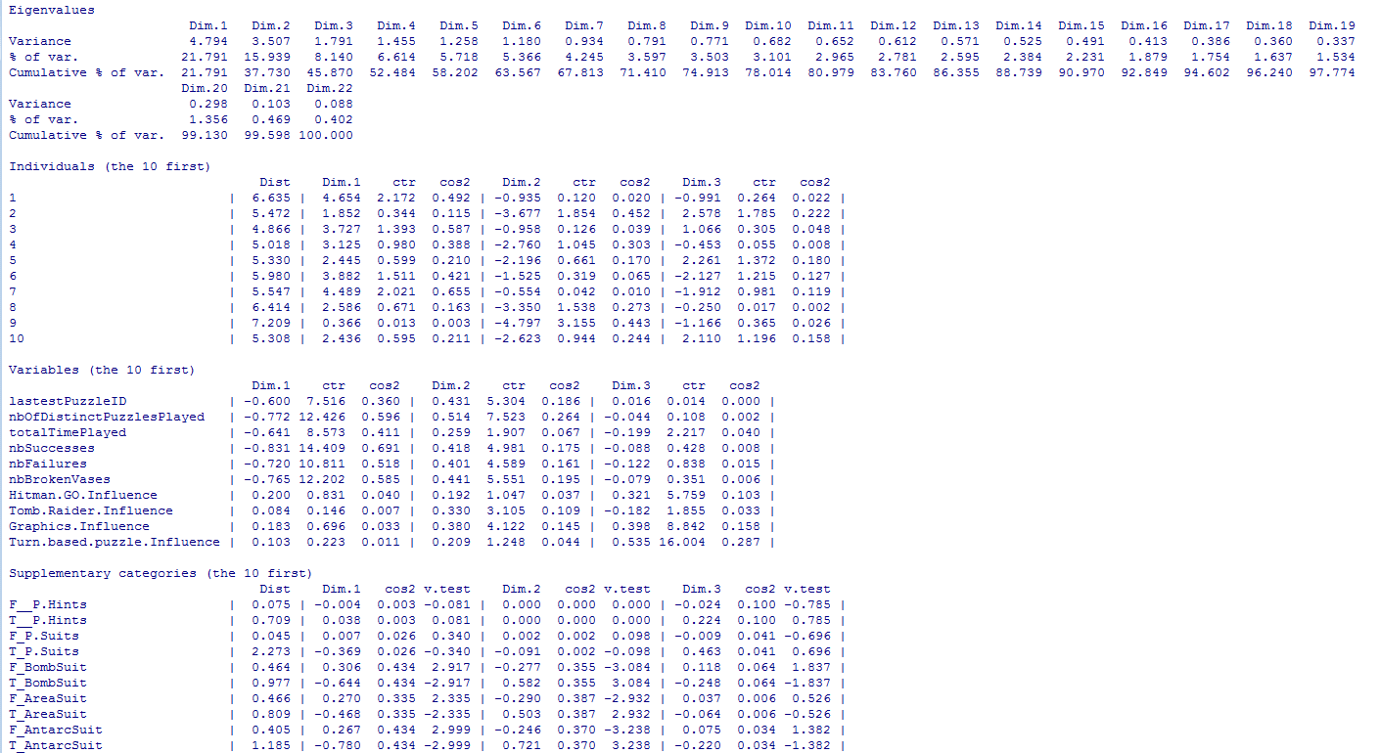
summary(mydata.sub.pca)
summary(mydata.sub.pca)
22 Dimensions therefore total variance = 22
Since data is scaled (columns mean == 0 and variance == 1), then total variance == number of dimensions
Rule of thumb, Dimensions that contribute to less than 1 can be dropped

Slide 9


summary(mydata.sub.pca)
We see that the first 7 dimensions account for 68% of the variance.
We see that the last 7 dimensions account for 9% of the variance

Slide 10
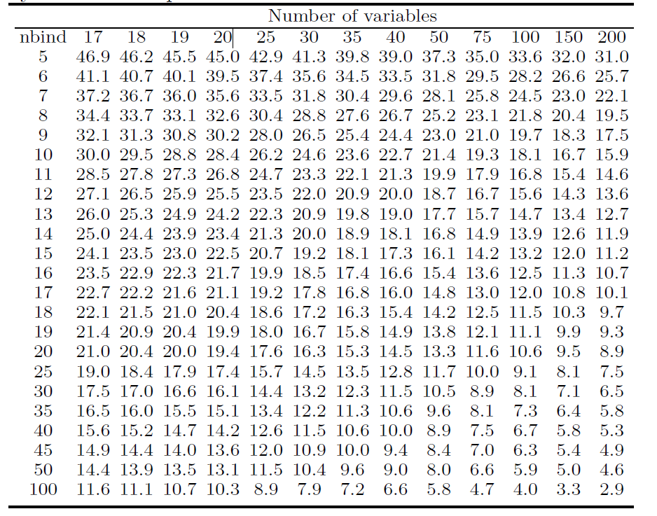
summary(mydata.sub.pca)
Table A.2 From Husson F et al. (you have the book)
Our data has more than 200 rows and we are using 22 variables to compute the PCA. So I’ll let’s look at 20 variables and 100 individuals.
According to the table: 95% of the percentages of inertia explained by the first two components are less than 10.3, which is significantly lower than 37.730
Ho: the percentage of inertia explained by the first two dimensions is not significantly greater than that obtained with (normally distributed) independent data @ 95%.

Slide 11
summary(mydata.sub.pca)
Dist
Distance of the individual from the origin of the PC axes
Dim.
position of the individual or variable on the axis
ctr
contribution (%) of the individual or variable on the axis [0, 100]
cos2
quality of representation of the individual or variable on the axis [0,1]
v.Test
The value of the v.test is generally comprised between 2 and -2. For a given variable category, if the absolute value is superior to 2, this means that the coordinate is significantly different from 0.

Slide 12
summary(mydata.sub.pca)
summary(mydata.sub.pca, nbelement=50, ncp=7)
Let’s look at the 50 variables

Slide 13
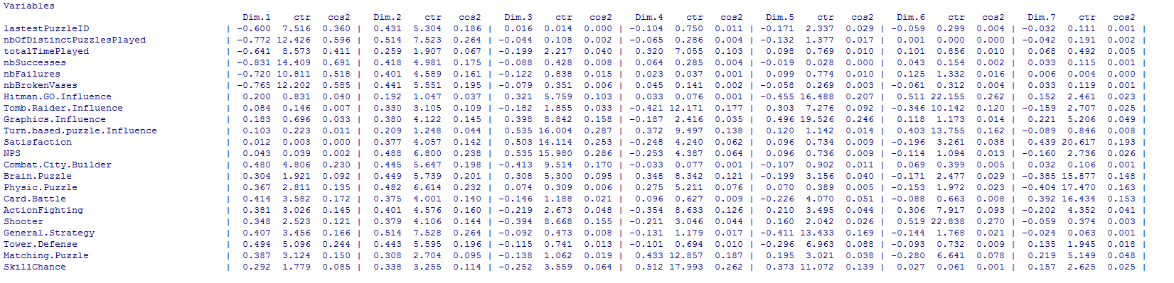
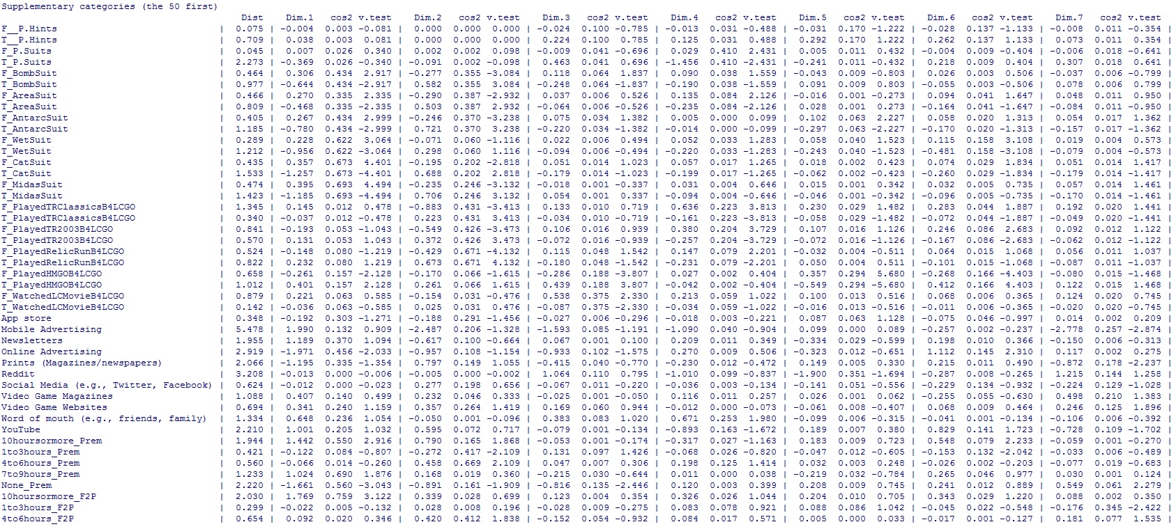
summary(mydata.sub.pca)
Dim.1
BI data is correlated (all negative)

Slide 14
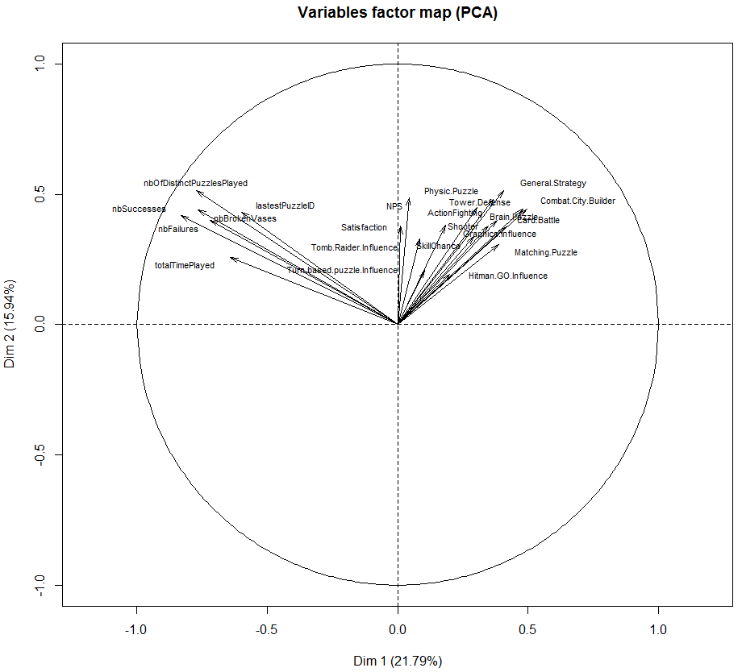
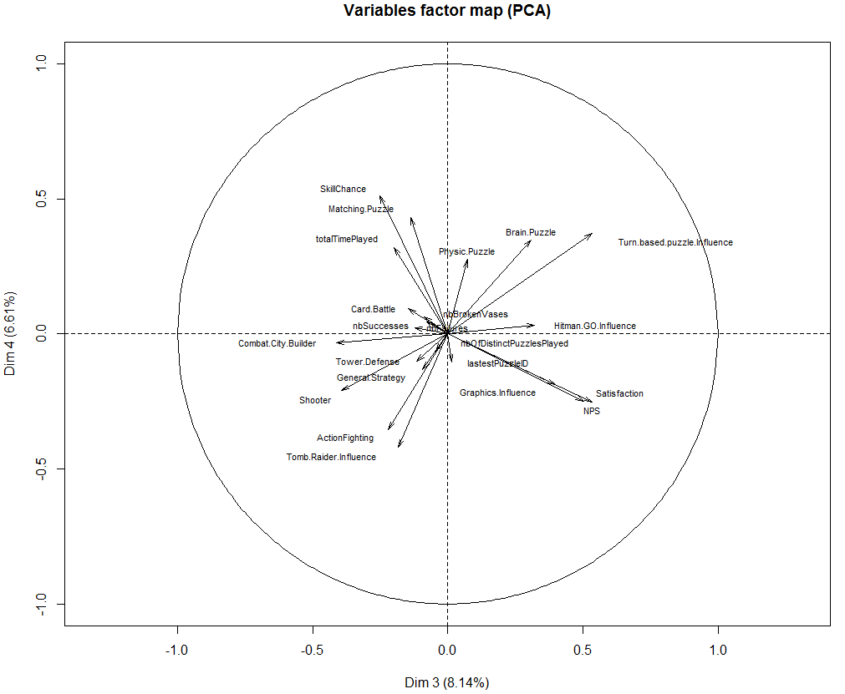
Correlation Circle
plot(mydata.sub.pca, choix='var', cex=.7, axes=c(1,2), new.plot = TRUE , xlim=range(-1:1), ylim=range(-1:1))
plot(mydata.sub.pca, choix='var', cex=.7, axes=c(3,4), new.plot = TRUE , xlim=range(-1:1), ylim=range(-1:1))
Closer to the circle’s outline == higher correlation
Dim.1 & Dim.2
This suggests that respondents who did not play LCGO much gave relatively high scores to game genres preferences…
Dim.3 and Dim.4
Respondents influenced (to purchase) by the Turn Based Puzzle characteristic of LCGO don’t like Shooter and Action Fighting games
Respondents who like Skill Chance and Matching Puzzle games gave LCGO a low NPS and Satisfaction rating score.

Slide 15
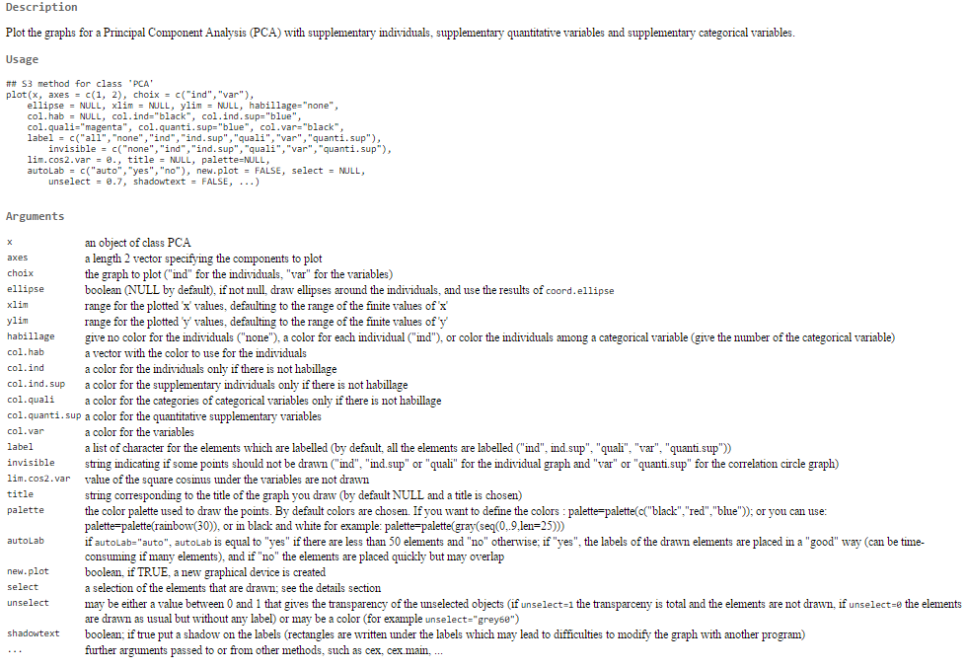
?plot.PCA
?plot.PCA

Slide 16
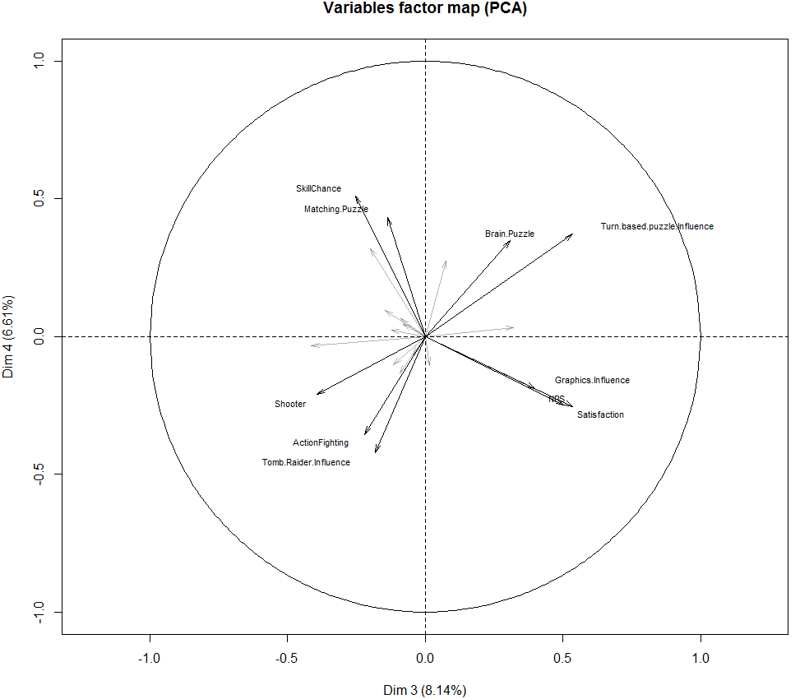
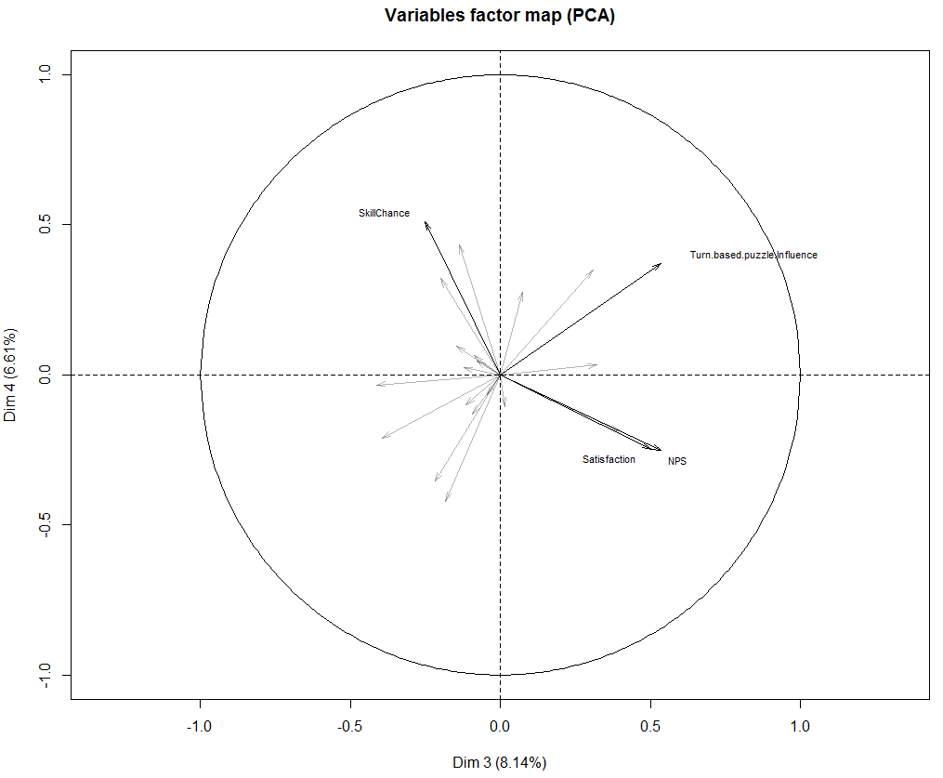
Correlation Circle – cos2
plot(mydata.sub.pca, choix='var', cex=.7, axes=c(3,4), new.plot = TRUE , xlim=range(-1:1), ylim=range(-1:1), select='cos2 10')
plot(mydata.sub.pca, choix='var', cex=.7, axes=c(3,4), new.plot = TRUE , xlim=range(-1:1), ylim=range(-1:1), select='cos2 0.3')
plot(mydata.sub.pca, choix='var', cex=.7, axes=c(3,4), new.plot = TRUE , xlim=range(-1:1), ylim=range(-1:1), select='contrib 10') ## try it!

Slide 17
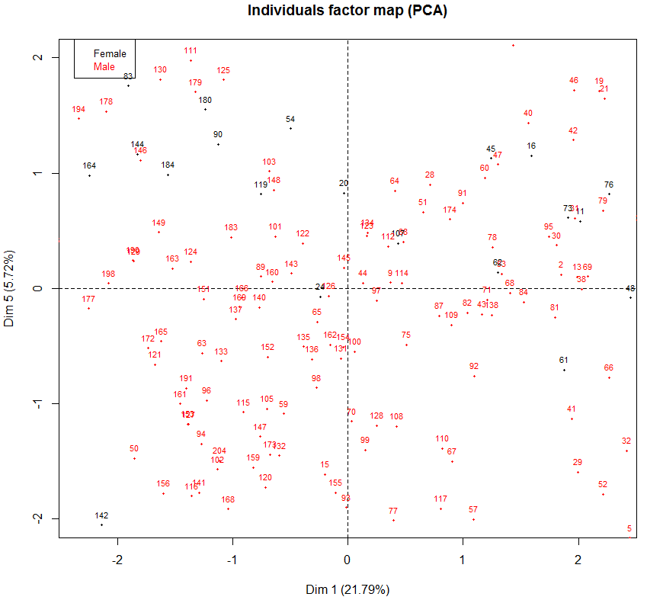
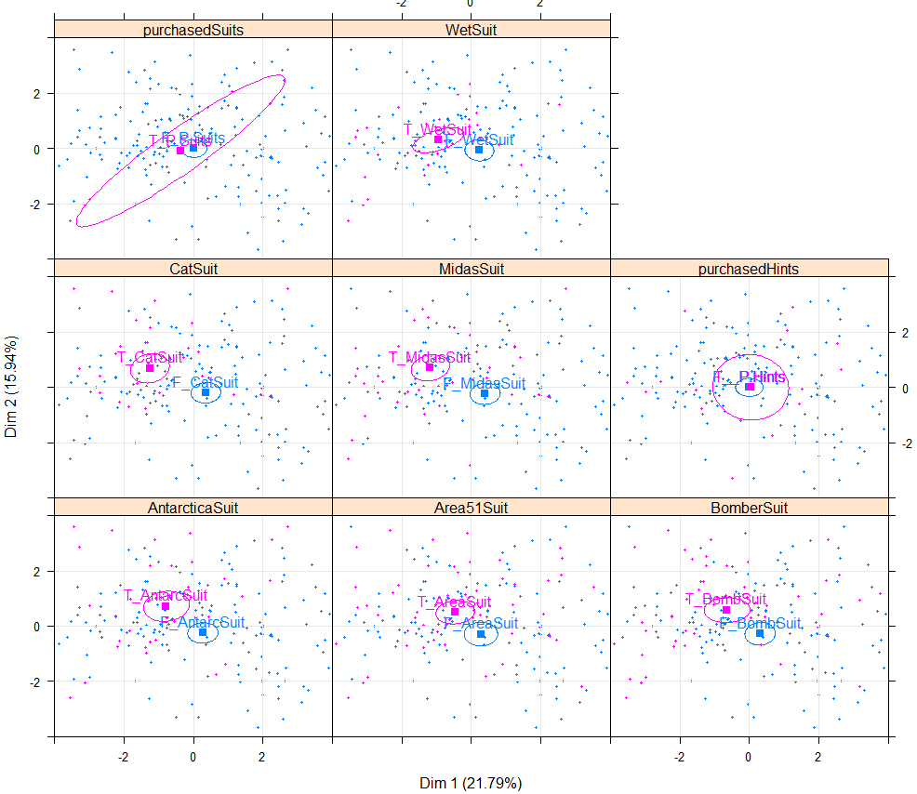
Individuals
plot(mydata.sub.pca, choix='ind', cex=.7, habillage=47, invisible='quali', new.plot = TRUE, xlim=range(-2:2), ylim=range(-2:2), axes=c(1,5))
plotellipses(mydata.sub.pca, keepvar=c(23:30), xlim=range(-4:4), ylim=range(-4:4), cex=.4, axis=c(1,2))
?plotellipses
Plotellipses draw confidence ellipses around the categories. They are used to visualize whether two categories are significantly different or not

Slide 18
HCPC
Our goal here is to construct archetypes of engaged players, i.e., personas.
We will explore the data using two PC approaches:
Perform hierarchical clustering on players behaviors with PCA
From the analysis we did so far, we know that suit acquisition correlates well with progression, so I don’t use them to compute the PCA. I will use suit acquisition as supplementary variables.
Perform hierarchical clustering on players’ survey responses with FAMD
I will compute a FAMD on the survey data and exclude the BI data.
Then I will perform HCPC on the results of the PCA and FAMD.
HCPC takes the information on all 10 dimension to build a classification. Here’s the code
mydata.sub.pca <- PCA(mydata.sub, quali.sup = 23:50, quanti.sup = 7:22, ncp=10, graph=FALSE )
mydata.sub.pca.hcpc <- HCPC(mydata.sub.pca) # WARNING: RStudio won't let you interact with the crossbow
mydata.sub.famd <- FAMD(mydata.sub, sup.var = c(0:6, 23:30), ncp=10, graph=FALSE )
?FAMD
mydata.sub.famd.hcpc <- HCPC(mydata.sub.famd)
names(mydata.sub.pca.hcpc) # same results for FAMD
[1] "data.clust" "desc.var" "desc.axes" "call" "desc.ind"
Note: Consolidation of the cluster is done with a k-means method, to make clusters more homogeneous. It’s possible to request HCPC to not consolidate the three, so there will be no consolidation after cutting the tree. Use this code:
mydata.sub.pca.hcpc <- HCPC(mydata.sub.pca, consol=FALSE)

Slide 19
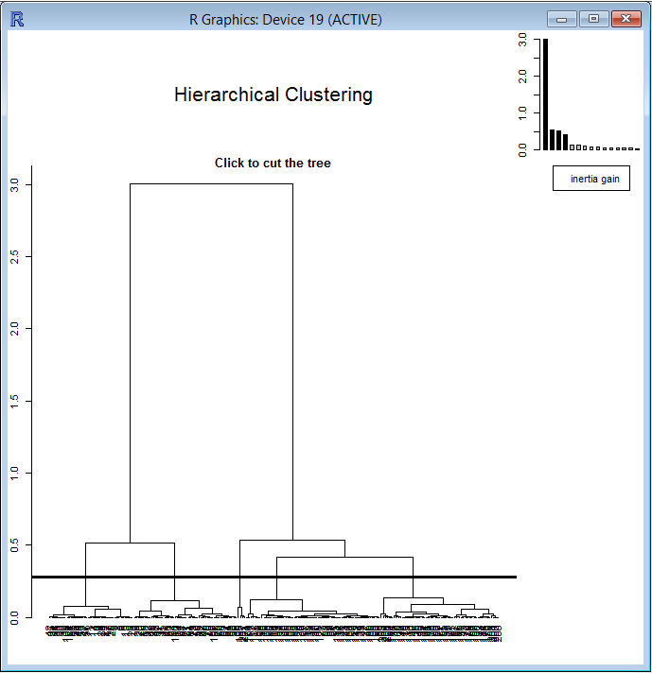
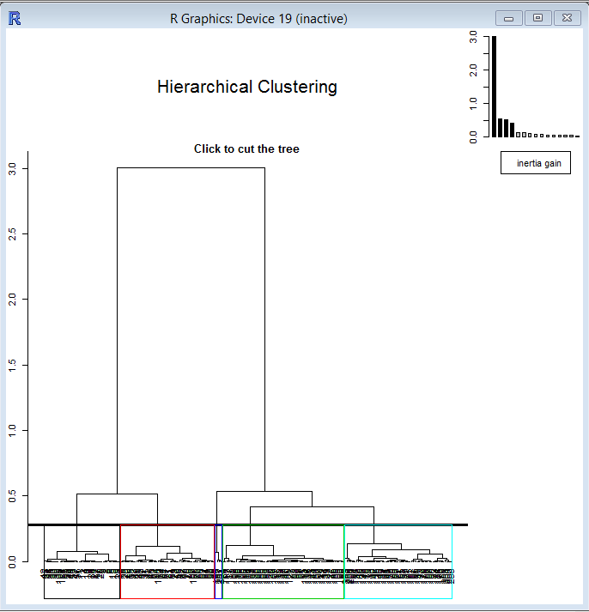
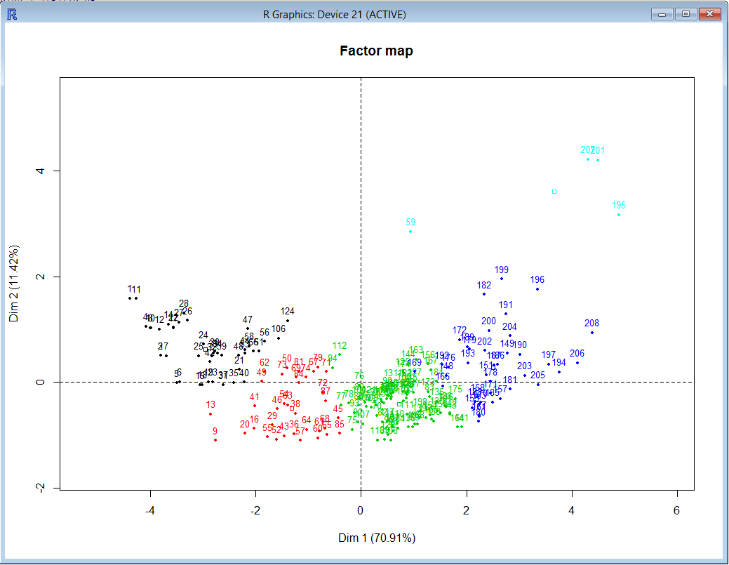
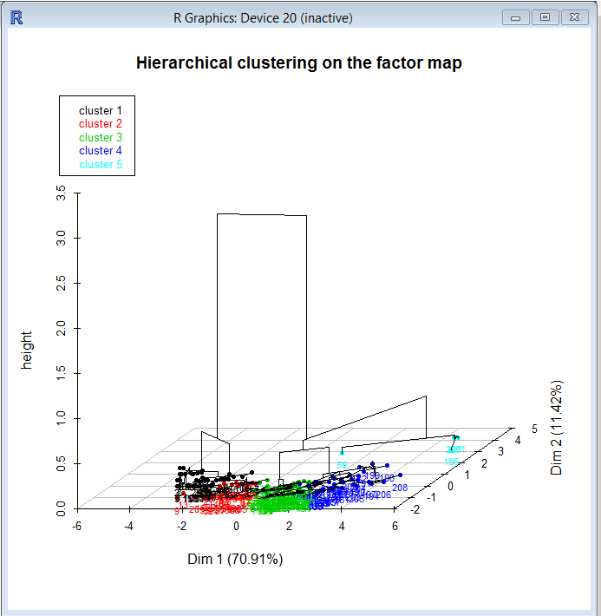
HCPC on PCA
Notes:
Consolidation of the cluster is done with a k-means method to make clusters more homogeneous, it’s possible to request HCPC to not consolidate the three, so there will be no consolidation after cutting the tree

Slide 20
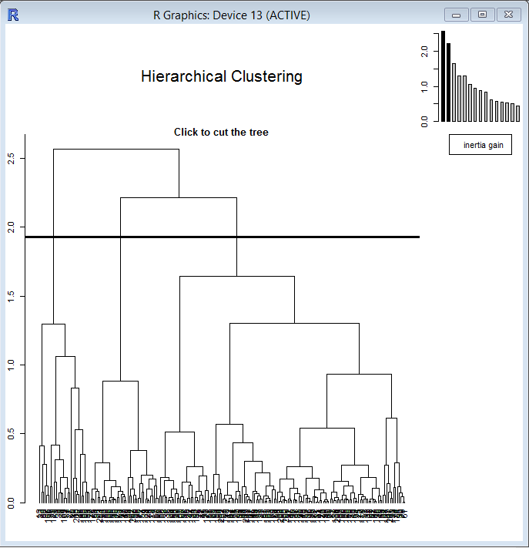
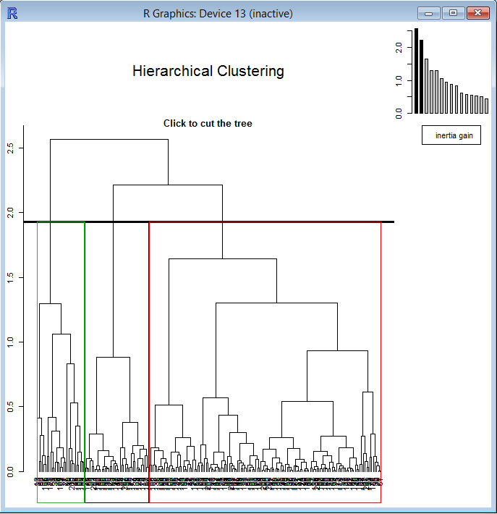
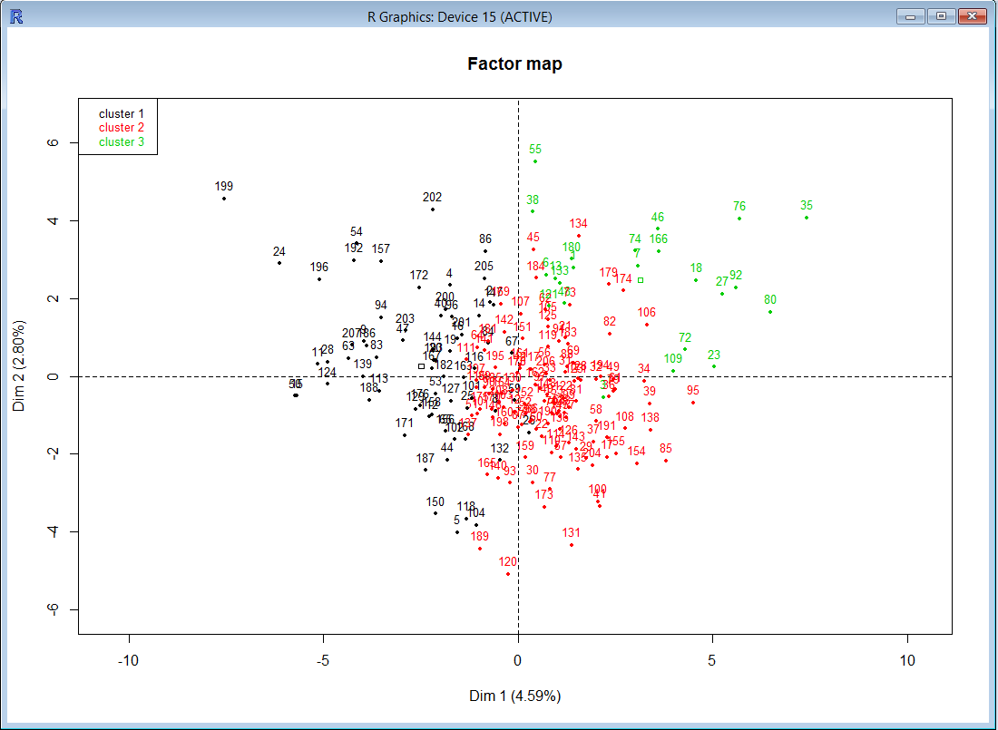
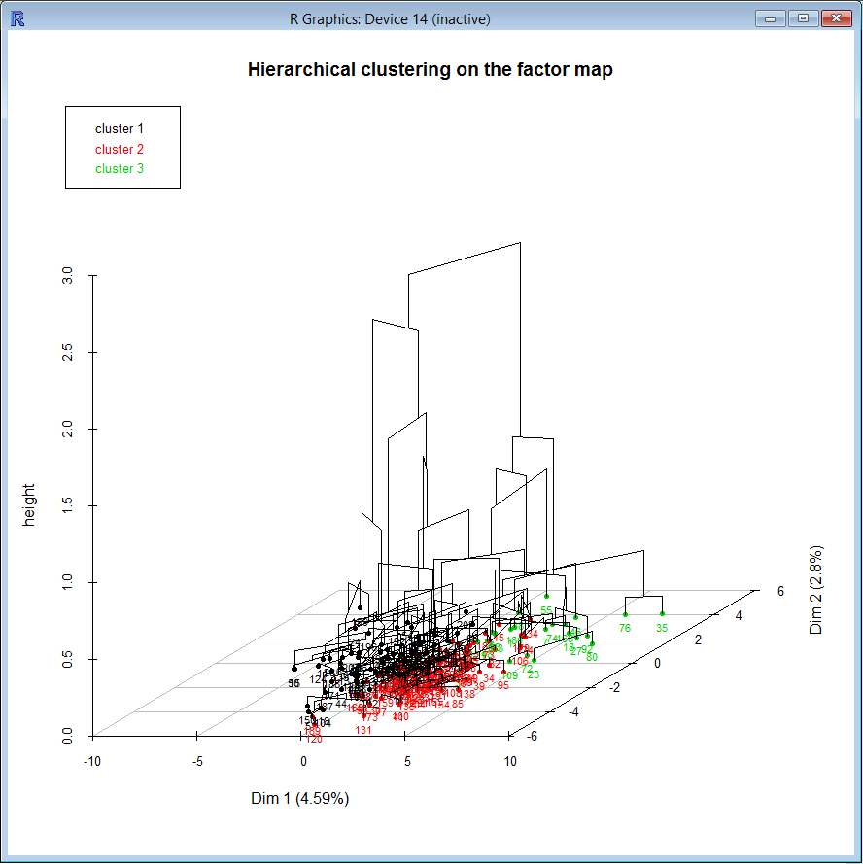
HCPC on FAMD

Slide 21
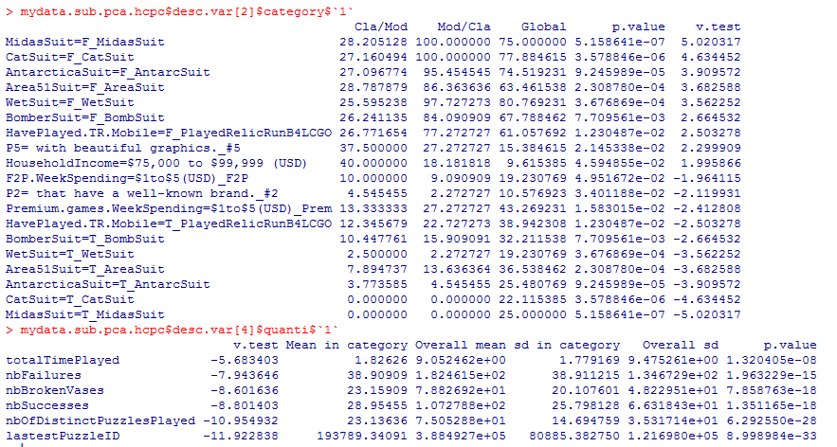
HCPC on PCA - desc.var
mydata.sub.pca.hcpc$desc.var # for everything or..
# easier to analyze when Category and quanti of the same dimensions are grouped together…
mydata.sub.pca.hcpc$desc.var$quanti$`1`
mydata.sub.pca.hcpc$desc.var$category$`1`
Category$1
28.2 % of F_MidasSuit are in category 1
100 % of all MidasSuit responses in category 1 are False (F_midasSuit)
Global: 75% of respondents did not get the Midas suit
The p-value of the test (5.15e-07) is provided along with the associated v-test (5.02).
The v-test corresponds to the quantile of the normal distribution associated with p-value; the sign indicates an over- or underrepresentation.
For example, the indiduals who did not get the Midas suit are most significantly characterized by the fact that they did not get any suit (orange highlight).
Quanti$1
A positive value of the v.test means that the variable takes a high value, a negative value means a low value
Mean in category and Overall mean is useful to see the mean value of individuals in that dimension compared to overall mean.

Slide 22
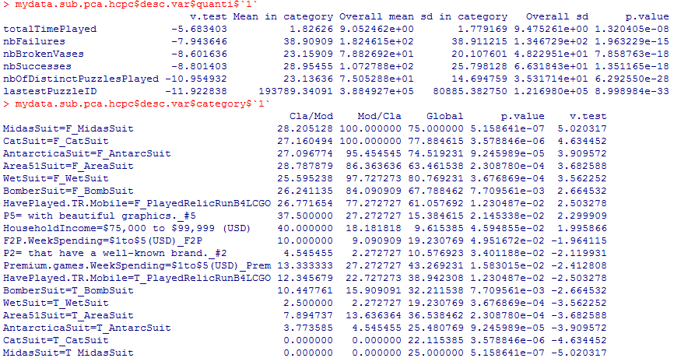
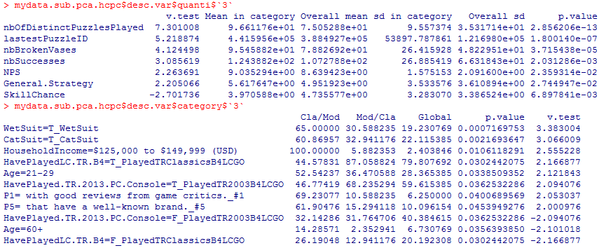
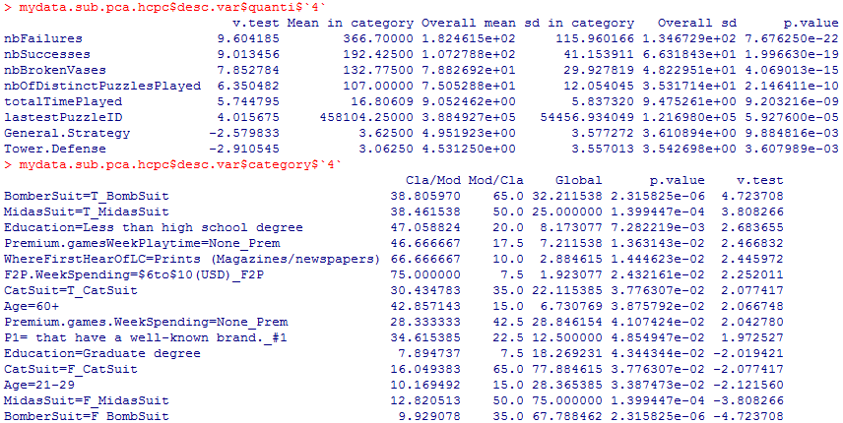
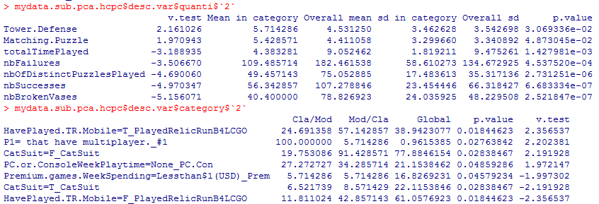
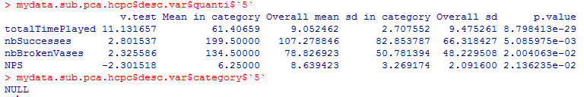
HCPC on PCA – 5 Dims
Dim 1
Dim 3
Did not progress much in the game (compared to the group)
Did not get new suits for Lara
Purchase decision: beautiful graphic has “some” importance
Did not play Relic Run
Has household income higher than the average
Played LCGO slightly more than the group
Don’t like Skill Chance games
Like General Strategy games
Broke more vases than the group
Would recommend LCGO
Got the Wet Suit and the Cat Suit
Have played TR
Have a high household income
Young adults
Buy games that get good reviews
Purchase decision: a well known brand has some importance
Dim 4
Have played much more than the average
Good LCGO players (progressed well)
Broke more vases that the group
Don’t like General Strategy games
Don’t like Tower Defense games
Got some suits, including the last one, but not all of them.
Low education
Old adults
Don’t normally spend money on premium games
Spend money on F2P games
Discovered LCGO with newspaper/magazines articles
Dim 2
Like Tower Defense and Matching Puzzle game genres
Did not collect Easter Eggs (break vases)
Did not play LCGO much
Played Relic Run
Buy games with multi-player features
Don’t play PC/Console games
Dim 5
Spent more time on the game than the group
Broke more vases than the average
But would not recommend the gam.
# Hint: use this to sort categories and quanti varaiables by v.test in absolute decreasing order
mydata.sub.pca.hcpc$desc.var$category$`2`[order(-abs(mydata.sub.pca.hcpc$desc.var$category$`2`[,5])),]
mydata.sub.pca.hcpc$desc.var$quanti$`2`[order(-abs(mydata.sub.pca.hcpc$desc.var$quanti$`2`[,1])),]

Slide 23
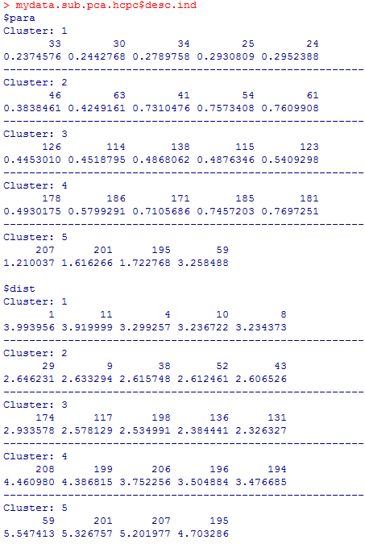
HCPC on PCA - desc.ind
$para : individual who are the closest to the center of gravity the dimension
$ dist : individuals who are the farthest of the other dimensions. These individuals are very specific the dimension.
Here, individuals 33, 30, 34, 25 and 24 are at the center of dimension 1, however, individuals 1, 11, 4, 10 and 8 are very specific to that dimension.
Let’s look at the original data

Slide 24
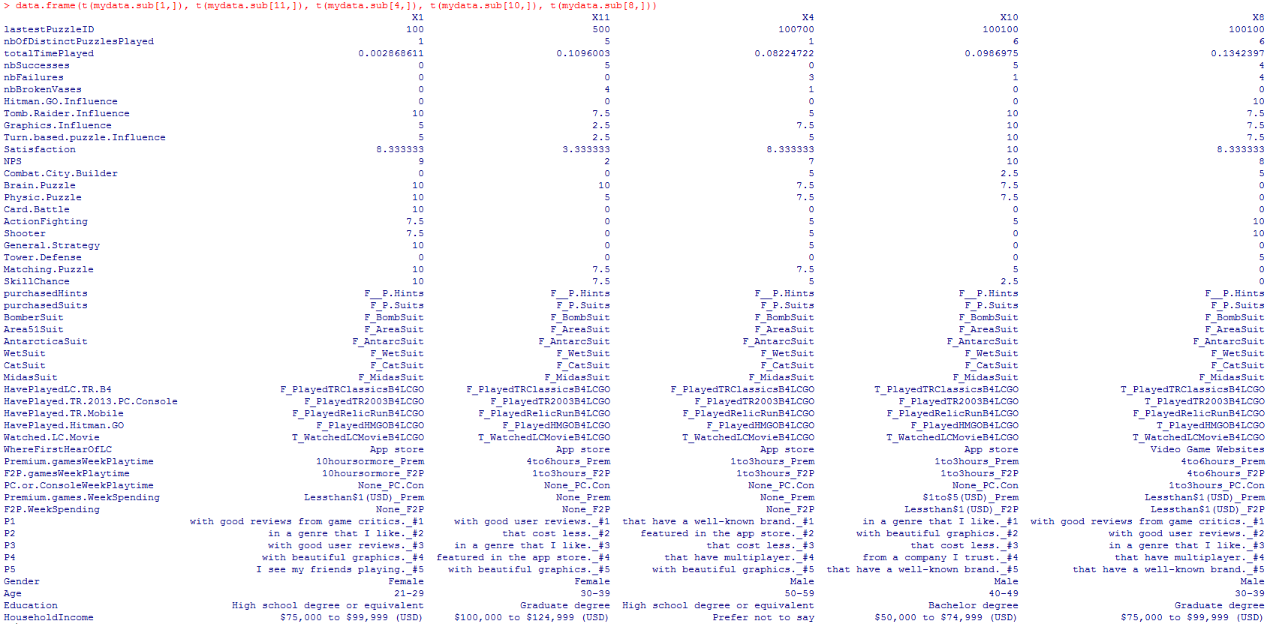
Dim1 - para: players 1, 11, 4, 10 and 8
data.frame(t(mydata.sub[1,]), t(mydata.sub[11,]), t(mydata.sub[4,]), t(mydata.sub[10,]), t(mydata.sub[8,]))

Slide 25
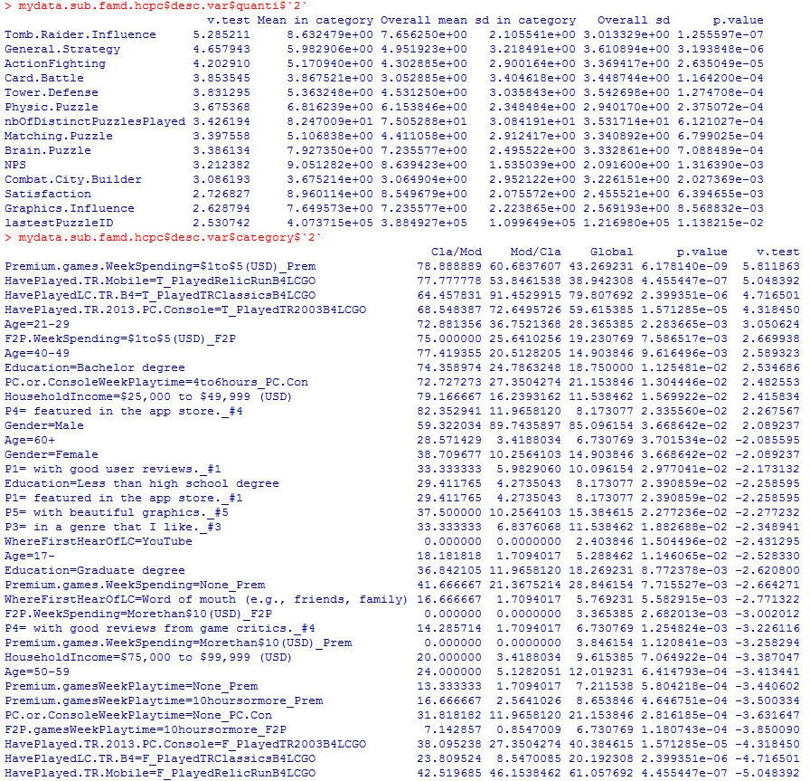
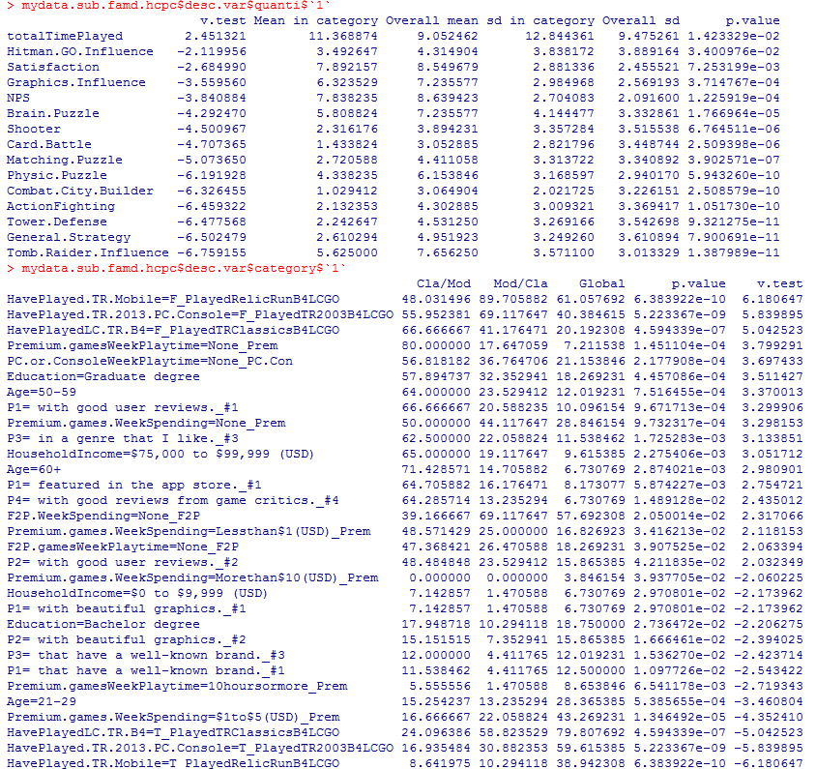
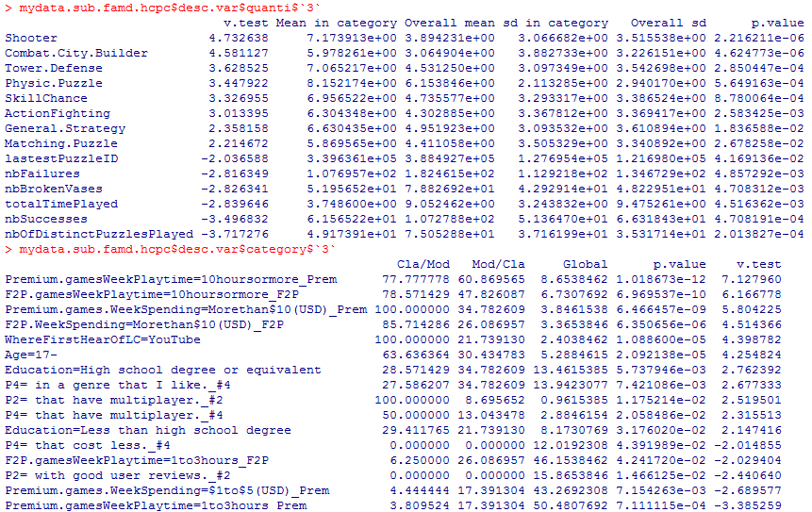
HCPC on FAMD – 3 Dims
Influence by the brand TR
Play videogames. Favorite genre: General Strategy. Least favorite genre: Combat City builder
More Satisfied and higher NPS than the rest of the group
Progressed more than the group
Sends in money on premium and F2P games
Play PC/Console games but not excessively
Between 21 and 50 y.o.
Educated
Mostly males
Average low income
Reviews and App Store Featuring do not influence them to purchase a game
Spent more time on LCGO than the group – worked harder?
Less influenced by the brand TR than the group
Normally not into videogames ( see game genre ratings)
Lower NPS and Satisfaction than the group
First time exposed to TR/LC brand
Don’t play PC/Console games
High education
High income
50+ years old
Well known brand has low influence on the decision to get a game
Good reviews has an influence on the decision to get a game
Spend $1 per week on games on average
Like all genres more than the group, but brain puzzle
Played LCGO less than the group
Spend much more time playing Premium and F2P games than the group
Spend much more money than the group
They have learned about LCGO from YouTube …
They are high school teenagers
They like multiplayer games

Slide 26
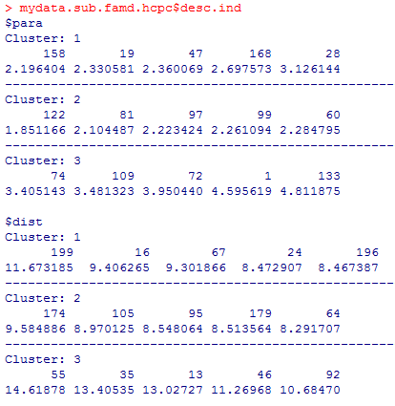
HCPC on FAMD – desc.ind

Slide 27
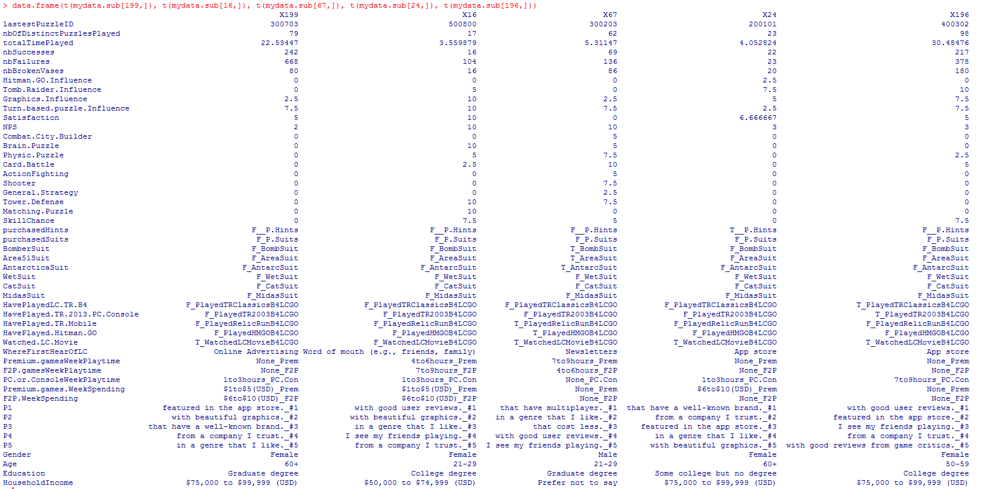
Dim1 – dist: players 199, 16, 67, 24, 196
data.frame(t(mydata.sub[199,]), t(mydata.sub[16,]), t(mydata.sub[67,]), t(mydata.sub[24,]), t(mydata.sub[196,]))

